Slide 1
Thyroid Project
Goals, Progress, and Next Steps

Slide 2
Overarching goal
To 1) distinguish NIFTPs from follicular adenomas and PTC-EFGs using ML-based image analysis, and 2) examine the similarities and variability of visual features among these classes.

Slide 3
Approach
Train a neural network to distinguish five histologic classes (incl. benign adenomas and four different carcinomas)
Apply the trained network to whole-slide images to validate performance
Visualize the final layer weights using t-SNE or UMAP to appreciate the relationship among the visual features detected in each of the classes

Slide 4
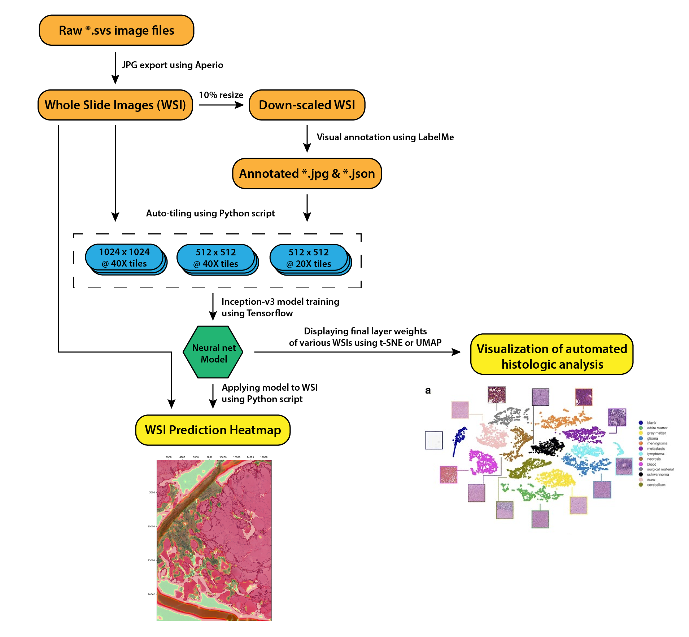

Slide 5
Active objectives
Determine appropriate tile size (pixels) for training
Determine appropriate tile size (magnification) for training
Apply pre-training with ImageNet
Validate pipeline using public repos with published parameters
Breast Cancer (BACH) repo
Validate pipeline using public repos with experimental parameters
Train pre-trained network on subset of thyroid tiles
Pre-train with histology images
Email Nicole for input re: image magnification
Sarah - coordinator

